Slide 1
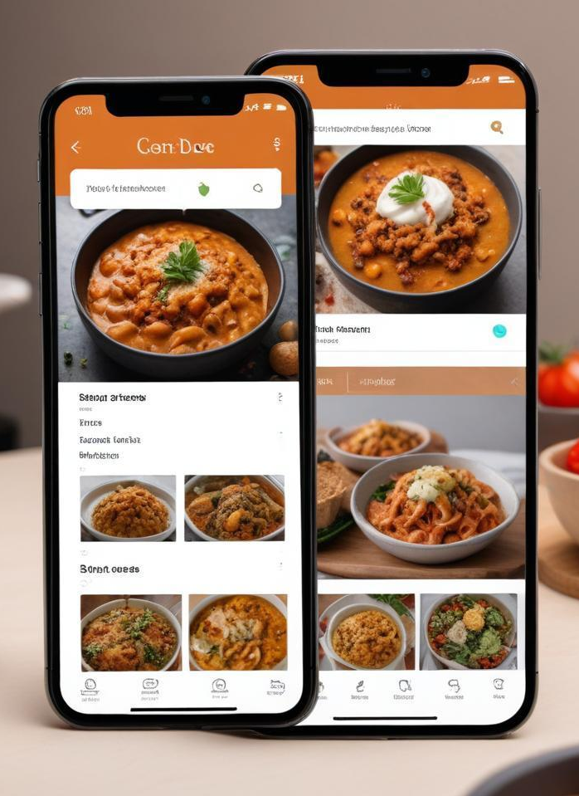
Recipe Sharing Platform
An Overview of Development with MERN STACK
By R.Keerthika(220901040)
3rd year Electrical and Electronics engineering R
from Rajalakshmi engineering college
Chennai

Slide 2
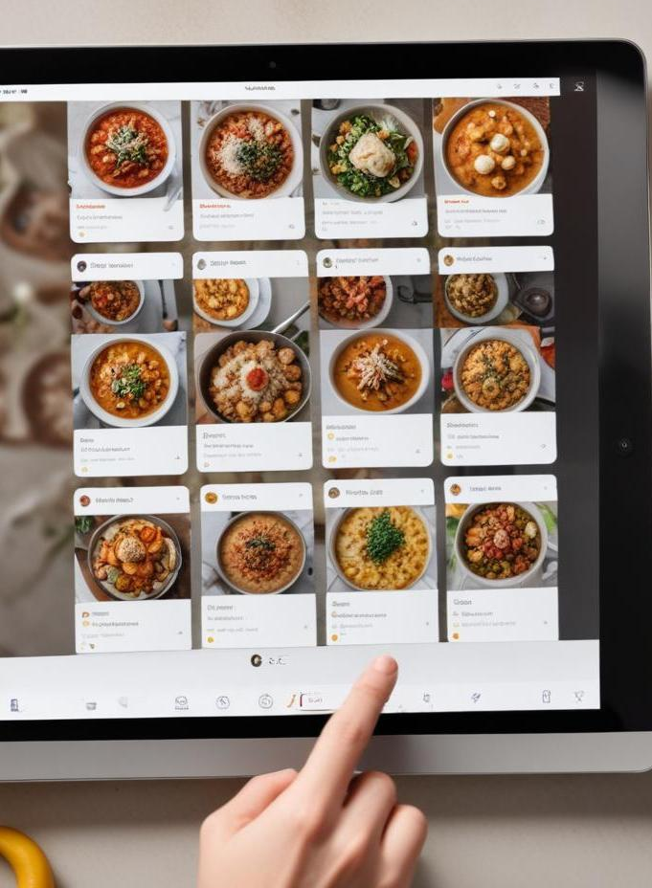
Introduction
This presentation outlines the development of a Recipe Sharing Platform using React and ExpressJS. It highlights the key features, technologies employed, and the overall user experience designed to facilitate recipe management and sharing.

Slide 3
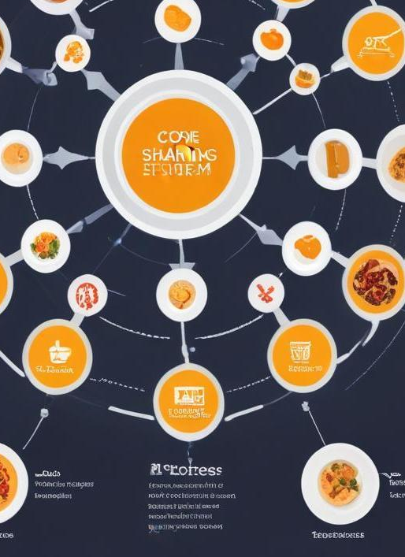
01
Platform Overview

Slide 4
Purpose and Features
The Recipe Sharing Platform is designed to allow users to create, share, and manage recipes with functionalities such as user authentication and collaborative features. Users can interact in real-time while simultaneously enjoying a streamlined and user-friendly interface. Key features include genre categorization of recipes, search functionality, and the option to bookmark favorite recipes.

Slide 5
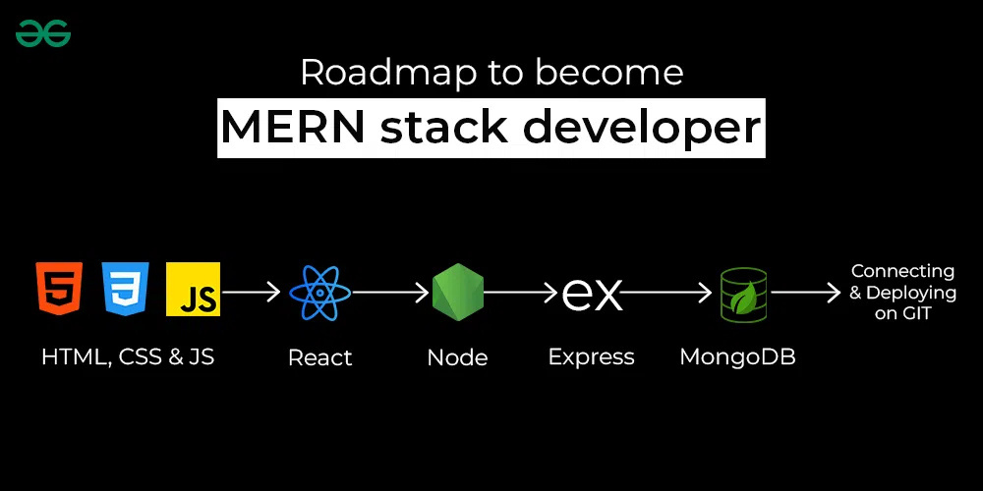
The platform is built using a modern tech stack including React.js for the frontend, which provides a vibrant user interface, and Express.js for the backend, handling requests and data management. MongoDB is used for database management, ensuring efficient storage and retrieval of user data and recipes. This combination allows for a responsive and dynamic application that supports real-time updates across all views.
Tech Stack Utilized

Slide 6
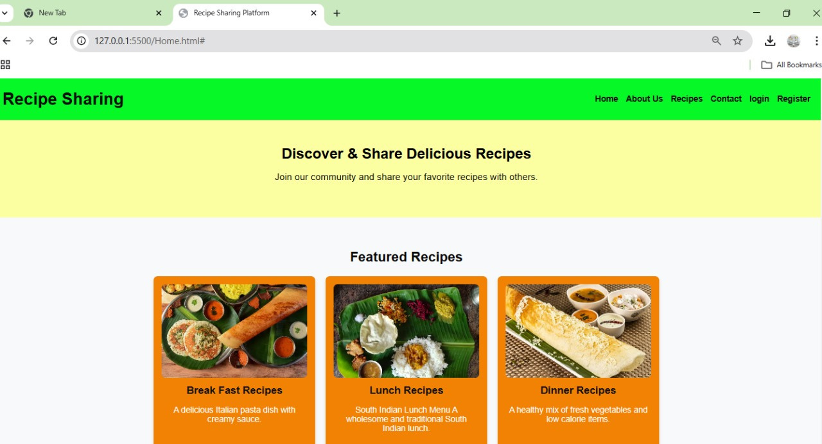
User Experience
The user experience of the Recipe Sharing Platform is designed to be intuitive and engaging. Users can easily navigate through recipes, search for specific dishes, and filter by various categories. An interactive interface allows for seamless recipe creation, with real-time previews of ingredients and instructions. Tooltips and guided prompts help users in the cooking and sharing processes, ensuring a smooth and enjoyable experience.

Slide 7

02
Development Process

Slide 8
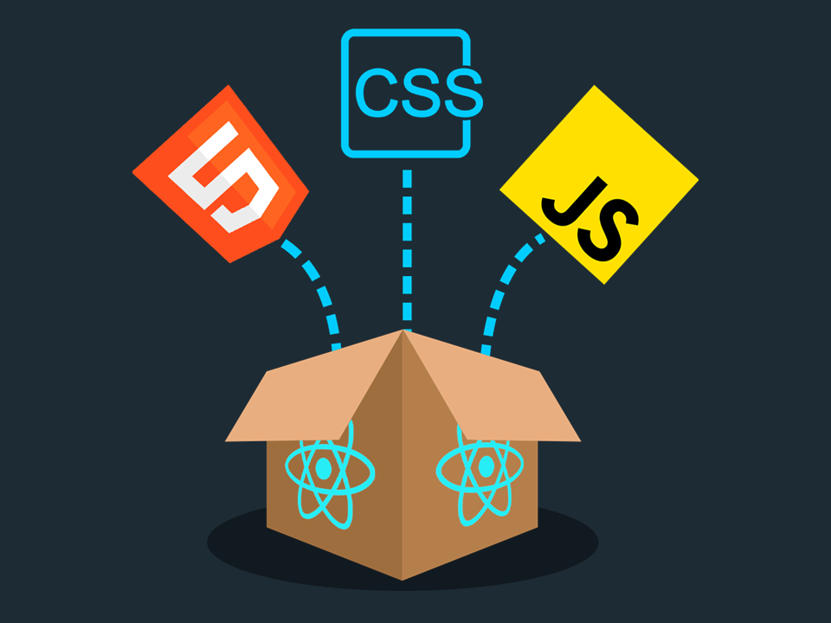
Frontend Implementation
The frontend of the Recipe Sharing Platform uses React.js to provide a dynamic user interface. Components are built to be reusable, which streamlines the development process. State management is handled through hooks or context API, ensuring that data flows efficiently between components. Additionally, responsive design principles create compatibility across devices, enhancing accessibility for all users.

Slide 9
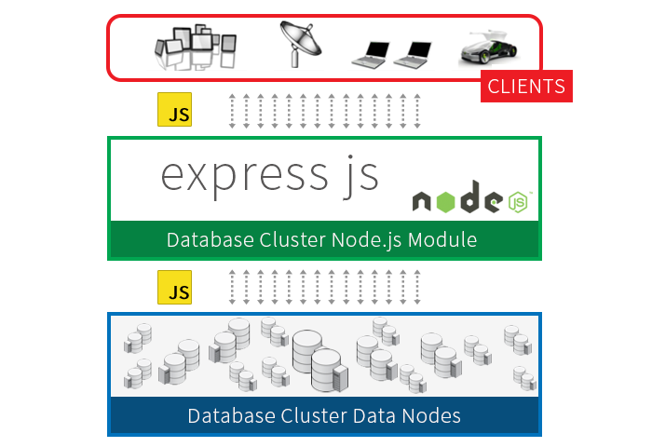
Backend Development
The backend is structured using Express.js to handle HTTP requests and manage routes efficiently. Middleware is utilized for processing requests and ensuring security with user authentication. MongoDB is employed as the database, allowing for scalable data management that supports various operations like CRUD methods for recipe handling and user data storage. This setup ensures that the platform can accommodate numerous users and simultaneous requests.

Slide 10
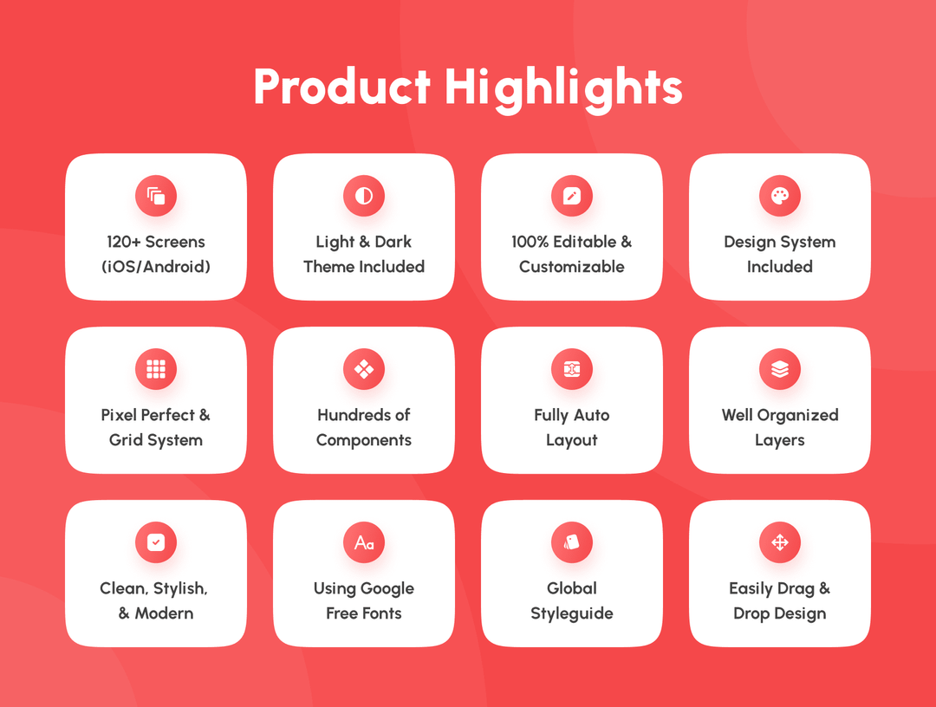
Collaboration and Real-time Features
Real-time features are implemented using WebSockets, which allow users to see changes in recipes or comments immediately as they happen. This collaborative environment encourages interaction among users, where they can share feedback, edit recipes jointly, and engage in discussions. Notifications alert users to updates, enhancing communication and a sense of community within the platform.

Slide 11
Conclusions
In summary, the Recipe Sharing Platform effectively combines modern web technologies to create a dynamic and user-friendly experience. By leveraging React and Express.js, the platform supports collaborative cooking, enhances user interaction, and facilitates real-time updates. The implementation of a versatile tech stack ensures a seamless experience for users sharing their culinary creations.

Slide 12
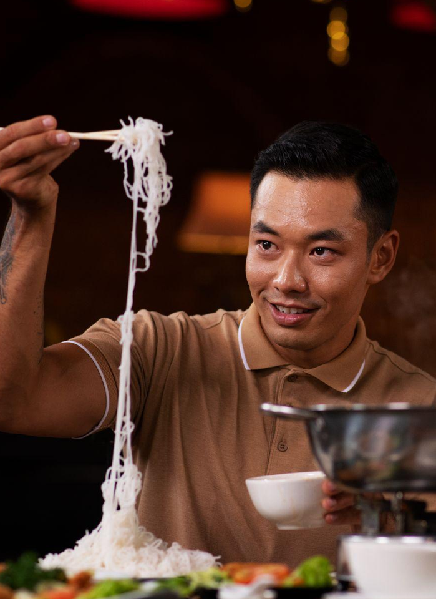
Thank you!

